Slide 1
SLR - semantic keywords for systematic literature reviews
Michał Gozdera, Małgorzata Hadasz, Krystian Kurek

Slide 2
Project goals
Motivation: Rapid pace of creating new literature in medicine field
Scientific goal: Solution helping to find the most suitable scientific publications based on keywords
Research question: Does the solution described above can be pre- pared with the use of the latest achievements in NLP domain?

Slide 3
Project content
1. Keywords extraction from medical papers abstracts
2. Tagging extracted keywords with ontologies concepts
3. Tags disambiguation

Slide 4
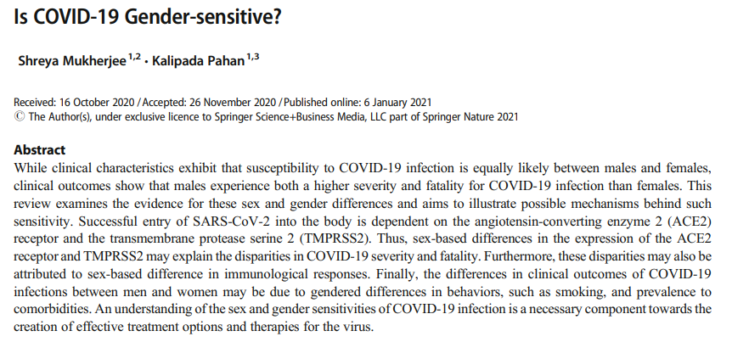
Example
Keywords extraction:
COVID19
Gender
Hypertension
Keywords ontology tagging:
COVID19 tags: illness, virus
Gender tags: gender
Hypertension tags: disease, blood pressure value
Keywords disambiguation:
COVID19 tags: virus
Gender tags: gender
Hypertension tags: disease
Mukherjee, S., Pahan, K. Is COVID-19 Gender-sensitive?. J Neuroimmune Pharmacol 16, 38–47 (2021). https://doi.org/10.1007/s11481-020-09974-z

Slide 5
Current solutions and state-of-the-art
Keywords extraction:
Latent Dirichlet Allocation – LDA (sklearn)
BERTopic (bertopic package)
Keywords tagging:
NBCO tagger (REST API)
Embedding-based tagger (implementation from scratch)
Tags disambiguation:
Closest Sense method (implementation from scratch)

Slide 6
Datasets & ontologies
Datasets
MedMentions
Ontologies
UMLS
The Human Disease Ontology
International Classification of Diseases

Slide 7
Significance of the project
Semantic keywords for systematic literature reviews - research & implmentation
Developing a tool that can be successully incorporated into research community - quality and speed of research work improvement

Slide 8
Concept, work plan, research methodology
Embedding taggger, NCBO tagger
BERTopic,
LDA
Articles (titles and abstracts)
Keywords
Concepts from ontologies

Slide 9
Specific research goals
acquiring wide knowledge about current state-of-the art methods in NLP domain, especially in semantic keywords for systemic literature reviews field
testing different solutions currently available and adapting them to the above need
combining existing methods for keywords retrieval, keywords ontology annotating and tags disambiguation into one, working solution
creating new algorithms for keywords ontology annotating and tags disambiguation

Slide 10
Risk analysis
Data
Data leakage
Data removal
Algorithms
Not satisfactory results
Change of privacy policy
Time shortage
Underestimation of the scope
Unrecognized ones
Team
Change of privacy policy
Communication issues
Mistakes made by a member

Slide 11
Methods, techniques, devices to be used in research

Slide 12
Keywords extraction – LDA (Latent Dirichlet Allocation)
1. Alex didn't like highly spiced food, so she decided to bake Cornish game hens for the base of the meal.
99% - food, 1% - computer games
2. On Unix, you can run make test at the top-level directory where Python was built.
95% - computer science, 5% - animals

Slide 13
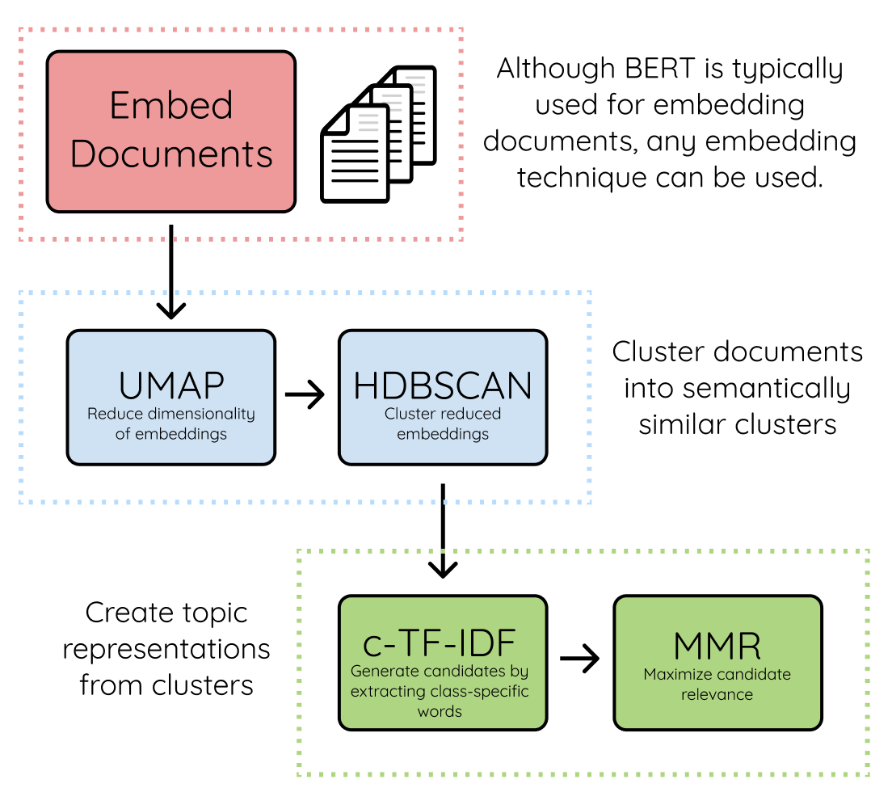
Keywords extraction - BERTopic
Sentence-BERT as a default
- Extension of traditional BERT (better for similarity)
Calculating the distance might become ill-defined
Modified TD-IF procedure - frequency of a term in the cluster
- documents from the same cluster concatenated

Slide 14
Tagging tools - NCBO
over 200 ontologies (still increasing)
How it works:
1. Direct string matching (input tokens matched to concepts from ontologies syntactically).
2. Searching for parents of concepts in ontologies.
3. Find relations between different ontologies.

Slide 15
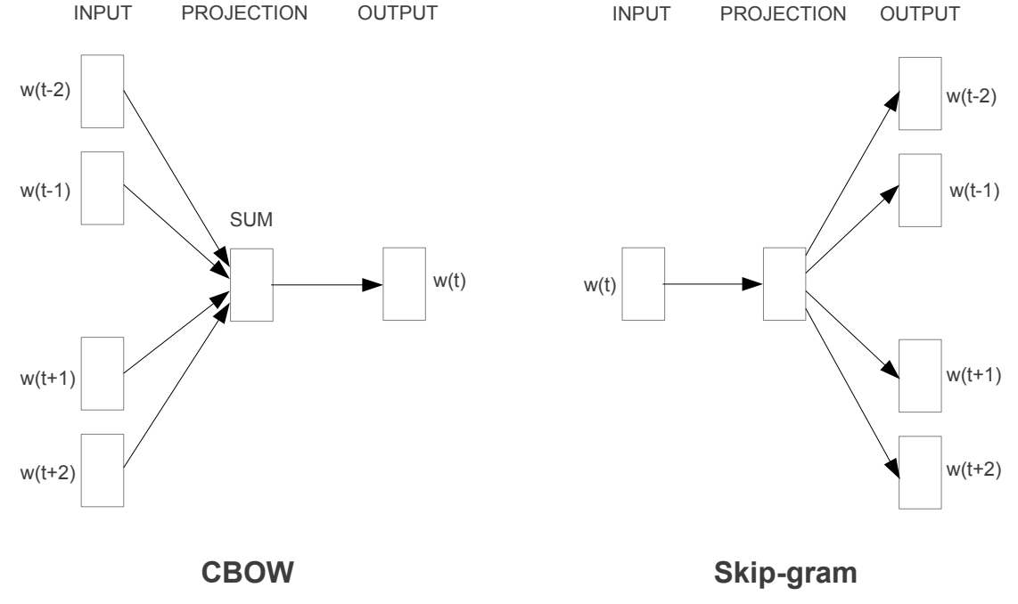
Word2Vec
Disadventages of usage one-hot encoded words:
same euclidean distance for every pair of vectors
cosine similarity between vectors is always equal to 0
Tomas Mikolov, Kai Chen, Greg Corrado, and Jeffrey Dean. 2013.
Efficient estimation of word representations in vector space.

Slide 16
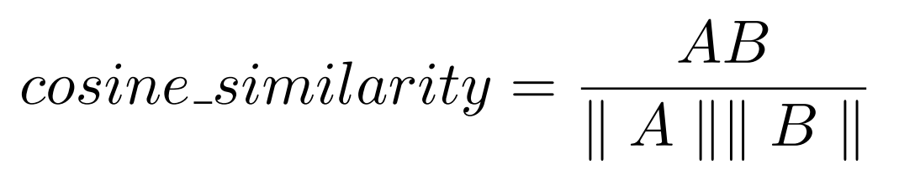
Tagging tools - words embedding tagger
Two similarity measures proposed in (Karadeniz and Ozgur, 2019)
WDA - word mover’s distance

Slide 17
Words tags disambiguation - Closest Sense method
Sentence-based Closest Sense method
sentence to tag:
I also tracked lipid profiles, HBA1C, blood pressure, body mass index, hostility and nicotine use
ambiguous: blood pressure
possible tags: organism function, diagnostic procedure and laboratory, test result
method:
Explore tags of other words appearing in the sentence.
For blood pressure choose the tag that is on average the closest to neighbouring tags.

Slide 18
Words tags disambiguation - Closest Sense method
Keywords-based Closest Sense method
extracted keywords:
red blood cells, blood pressure, cholesterol
ambiguous: all 3 keywords
possible tags: annotations from ontologies
method:
For i=1,…,max_iter:
1. Take subsequent keyword as ambiguous; treat other tag words as final
2. For each candidate tag of the ambiguous word calculate similarity measure to neighbouring tags and sort candidate tags accordingly

Slide 19
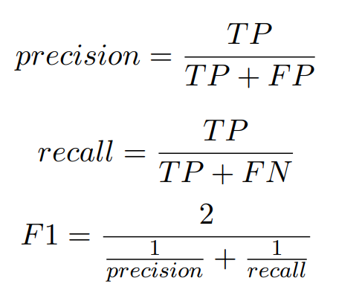
Methods of results analysis
 | In our annotations? | In golden standard annotations?
TP | ✅ | ✅
TN | ? | ?
FP | ✅ | ❌
FN | ❌ | ✅

Slide 20
Thank you for your attention

